Slide 1
Getting Started with AWS Cloud

Slide 2
Cloud Computing ?
Benefits of CC:
Pay as you go i.e, pay only for how much you use.
Lower in cost than on-premises.
Increased speed & agility, flexible storage capacity.
We can easily deploy applications in multiple region within a minute.
CC is the on-demand delivery of IT resources over the internet.

Slide 3
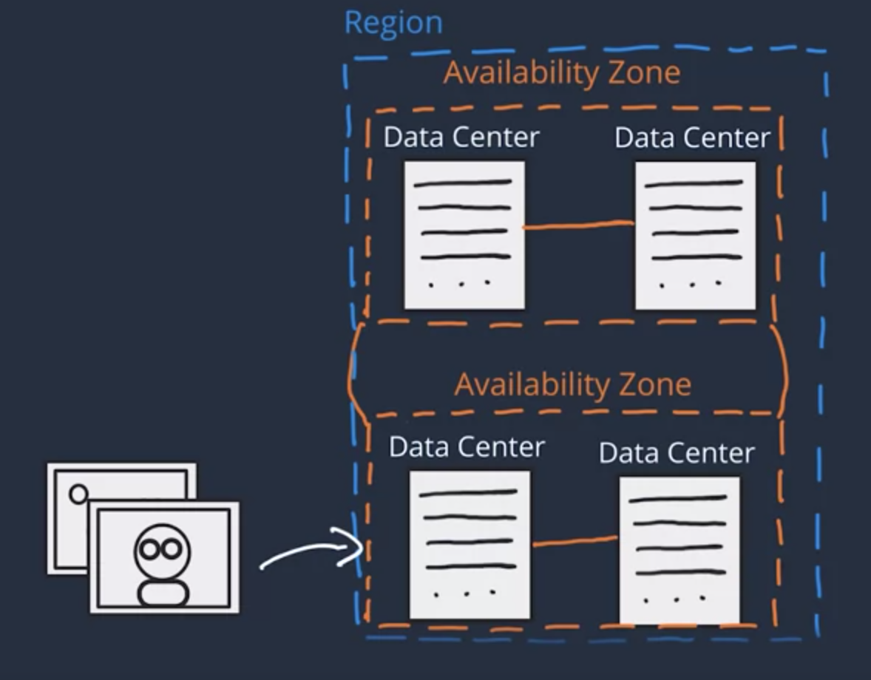
AWS Global Infrastructure
In AWS, the physical infrastructure makes up the AWS global infra, in the form of AZs and regions. AZ = Availability Zones

Slide 4
Interacting with AWS
Methods to make API call in AWS:
AWS management console.
AWS command line interface.
AWS software development kits.
Every action in AWS is an API call that is authenticated & authorized.

Slide 5
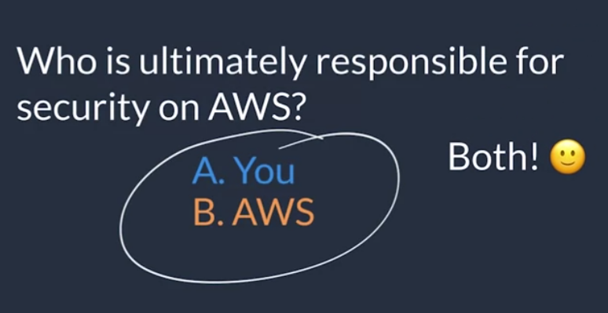
Security & AWS Shared Responsibility
AWS for security of the cloud.
Customer for security in the cloud.

Slide 6
Shared responsibility model
AWS is responsible for: A. Protect & secure infrastructure that runs all the service. B. Protecting regions, AZs, data centers. C. Manage hardware, software, and networking components that run the AWS services, etc.
Customer is responsible for: A. Controlling the OS and application platform. B. Managing customer data, encrypting the data, protecting through network firewall. C, Proper configuration of services and applications.
AWS
Customer

